Slide 1


MINE SWEEPER
Christian Salazar | Jonathan Clark | Colton Stevens | Muze Makiese

Slide 2
PROBLEM STATEMENT
*Mine fields are dangerous to clear with human hands. Even more so in forest-dense areas.
*Mine Sweeper eliminates personnel danger with a combination of autonomous and manual steering, sweeping the area and deactivating mines without the need for human hands.
*Mine Sweeper has a driver navigating through a GUI to make sure we don’t miss a single mine in the process.

Slide 3
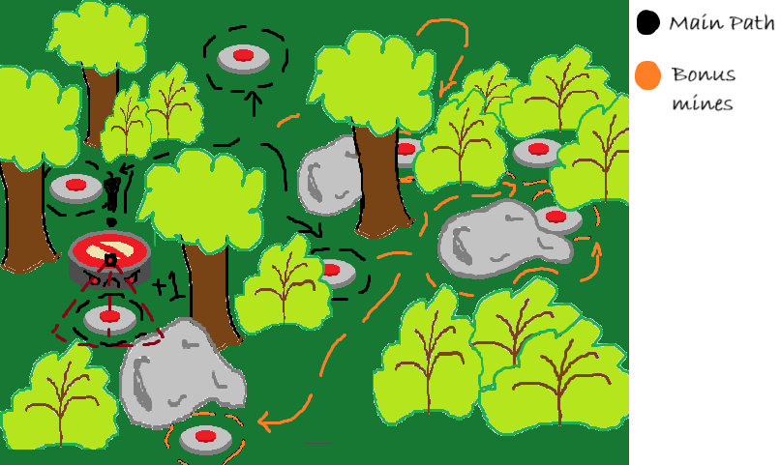
Problem Sketch

Slide 4
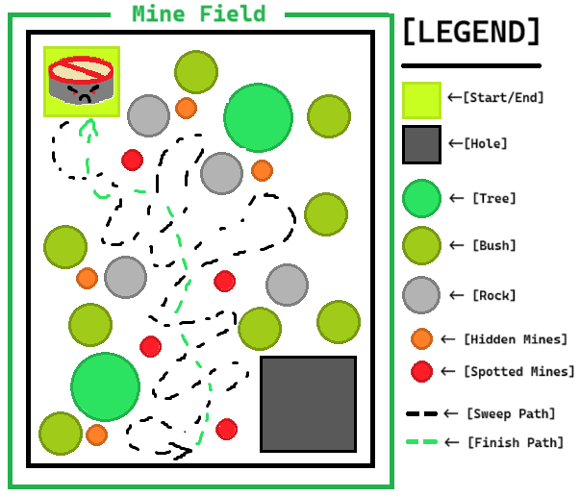
TEST FIELD SKETCH
*Test field imitates a dense forest area where a known minefield has been sectioned off.
*Mine Sweeper gets placed in a starting position and proceeds to do a sweeping motion as it traverses the field.
*While sweeping, Mine Sweeper must be careful not to bump into the mines or else catastrophe will happen.
*Notice there are 2 variants of mines.
“Spotted mines” indicate mines along a clear walking path.
“Hidden Mines” indicate mines outside of plain view (i.e. placed near shrubbery or in a group of rocks).
*Once Mine Sweeper has cleared the minefield, it will make it’s return back to where it started to indicate a finished job and will be ready for pickup.

Slide 5
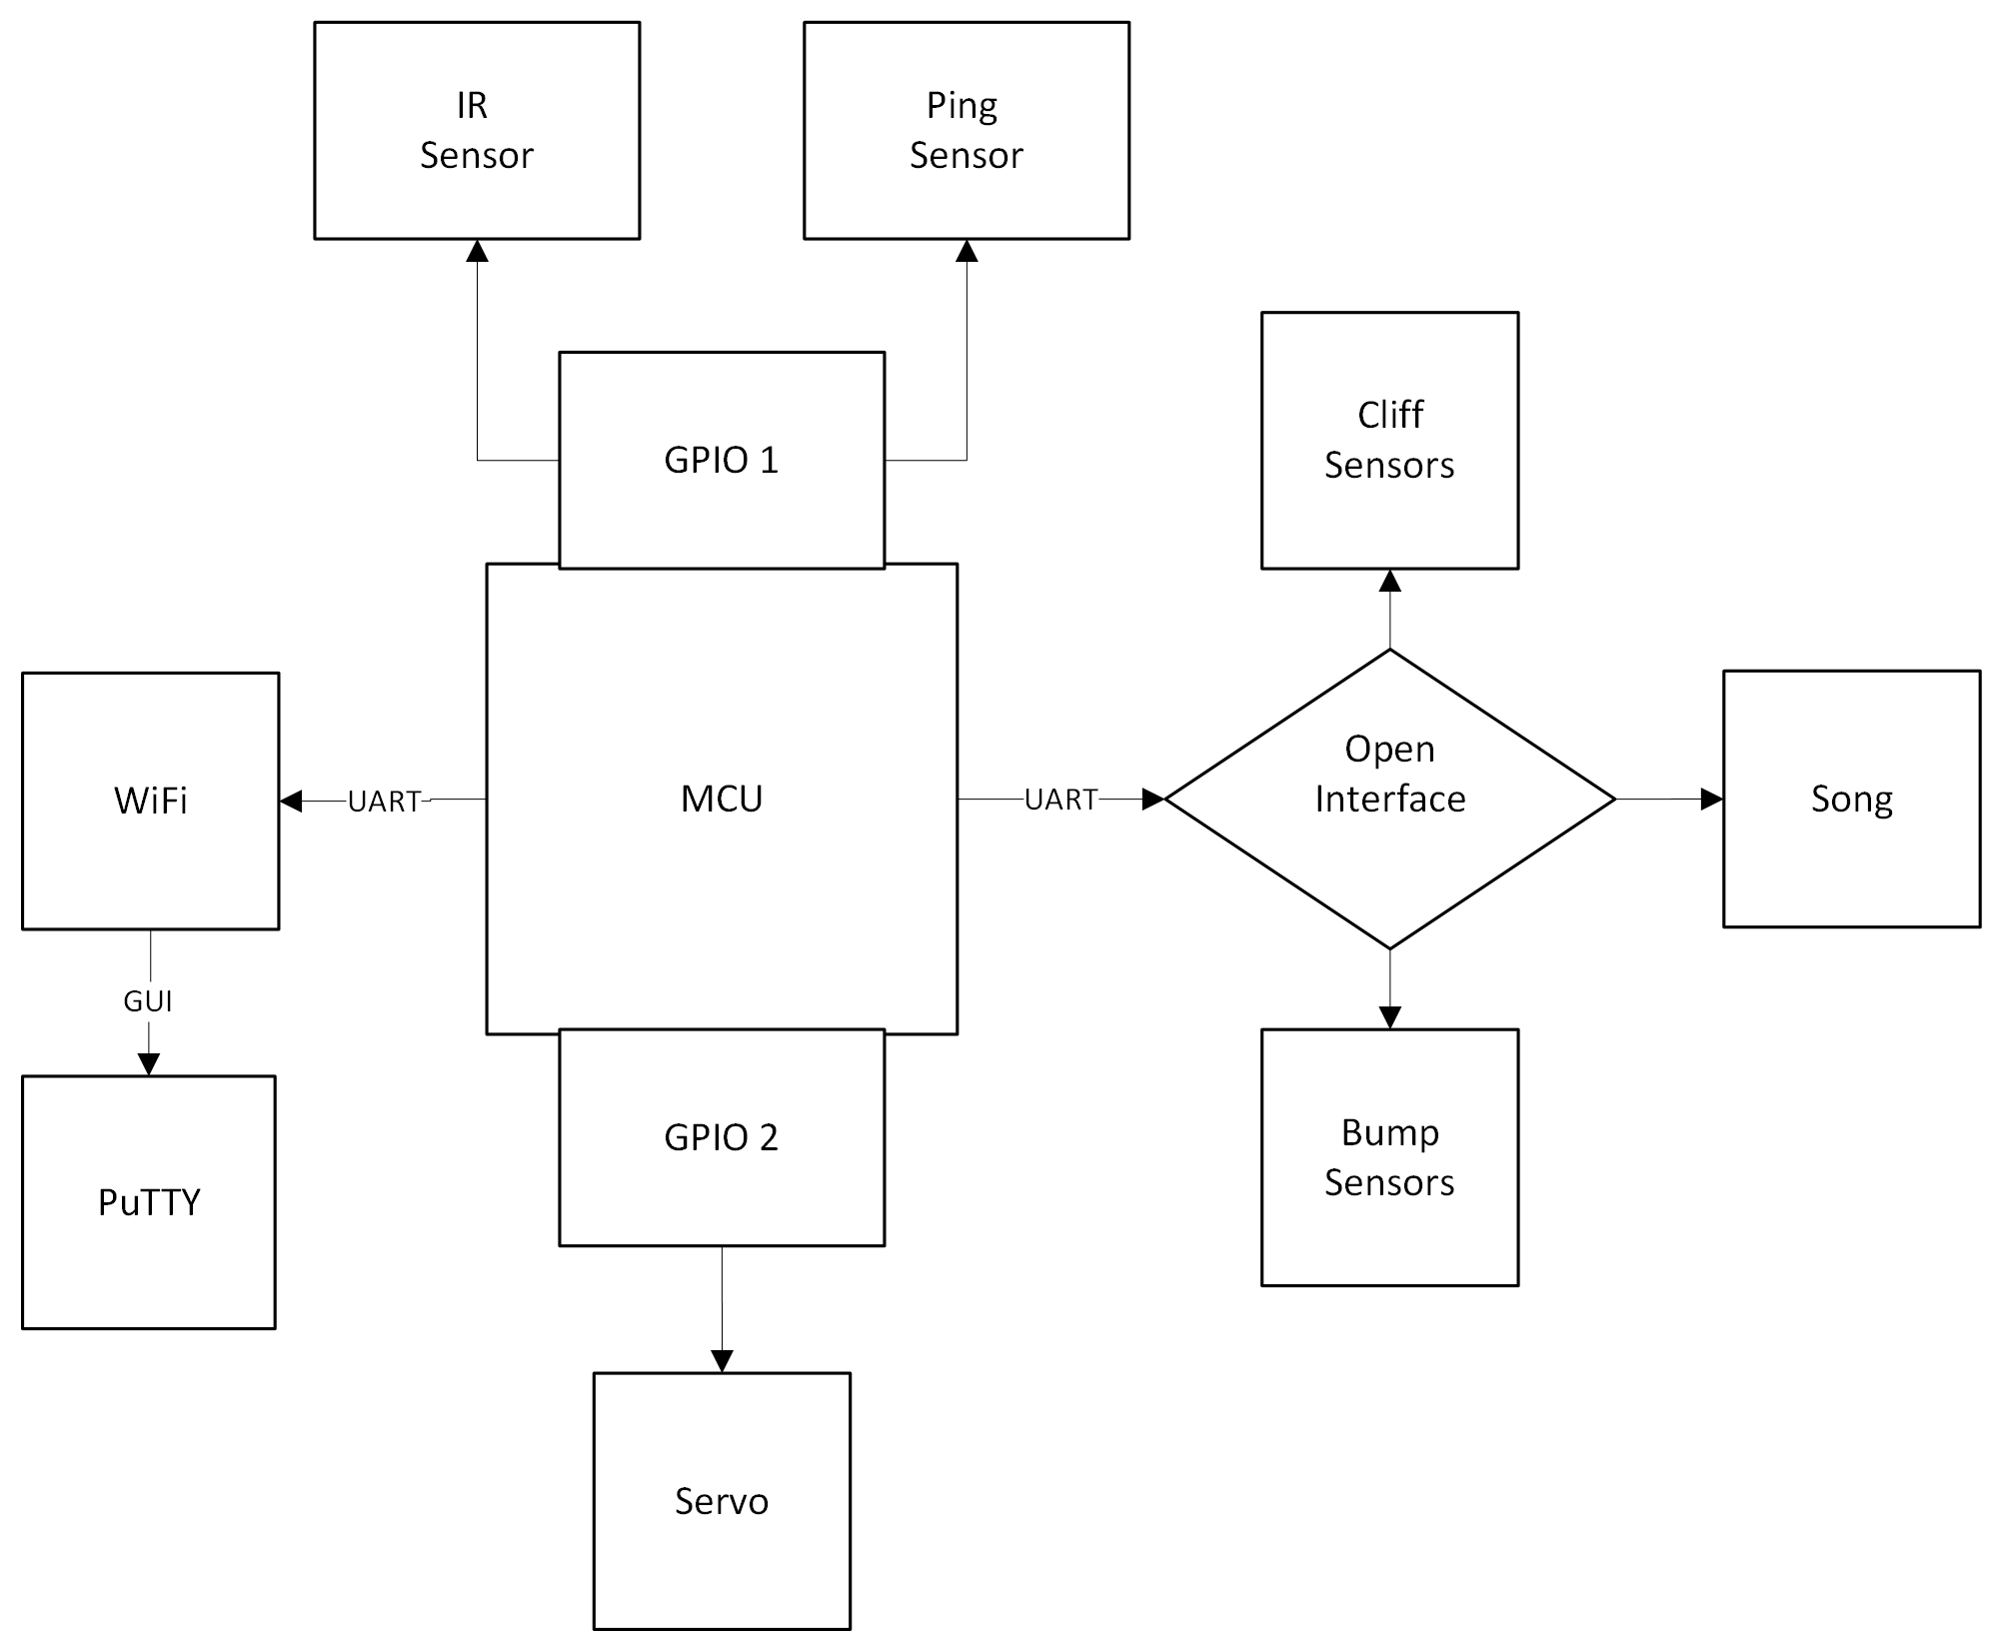
Technical Sketch

